Slide 1

Planify
Master Your Time,
Own Your Life!
2025.03.02

Slide 2
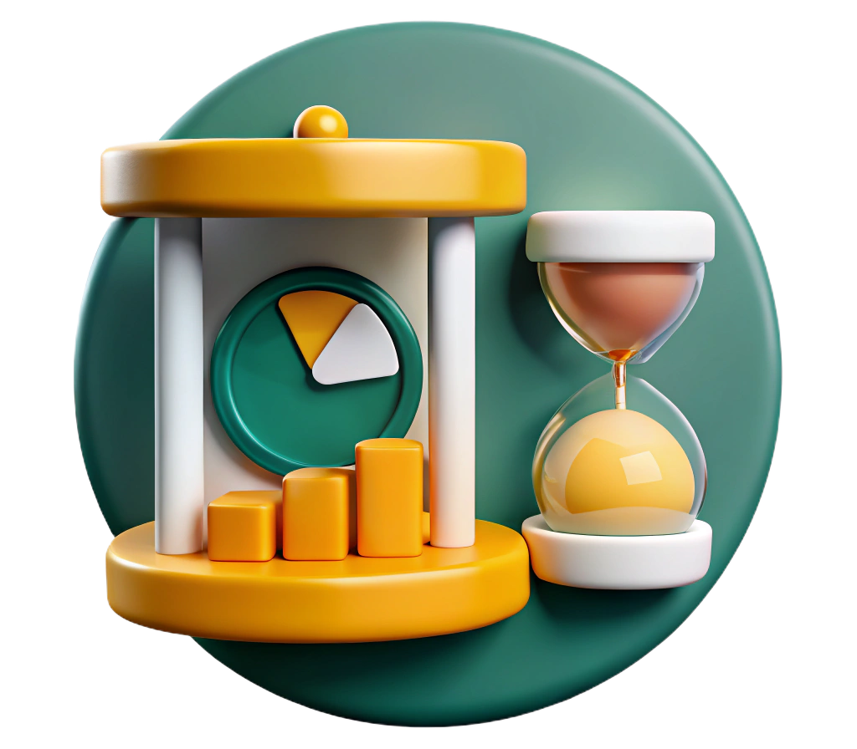
The problem
Inefficient time management and poor productivity lead to missed deadlines, increased stress, and reduced work quality.

Slide 3

The solution
An AI based mobile application which helps to achieve the best version of yourself!

Slide 4

Teamwork
Effective teamwork improves productivity and meets deadlines successfully.

Slide 5







Architectural diagram
Backend
Database
Authentication
Frontend
AI Backend
AI Model

Slide 6
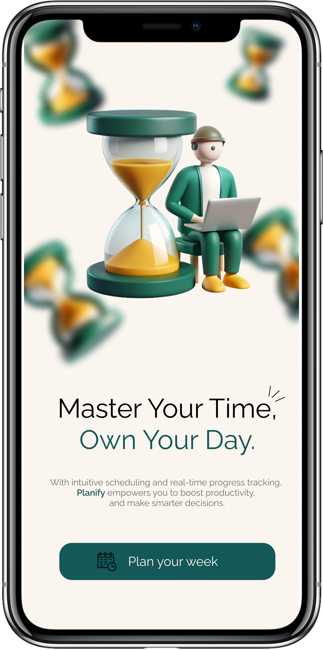
Demo time

Slide 7

Opportunities for further development
Public event recommendations with many more categories
AI model improvement
Enjoying activities with your friends

Slide 8
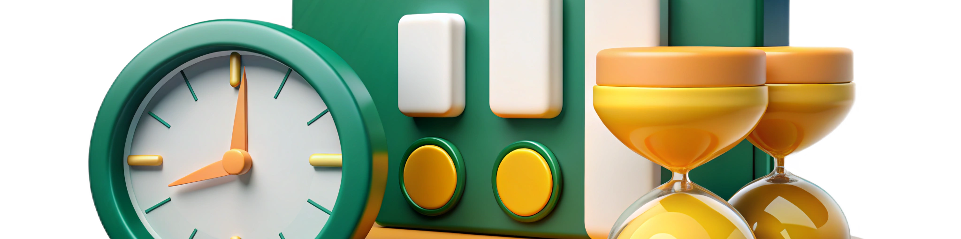
Thank you! :)
Team members - Dezső Szabolcs | Kádár Ákos-Gergő | Orbán Botond
Team name - coDestructor()

